Slide 1
Employee Data Analysis using Excel
STUDENT NAME:SHANKARAN.N REGISTER NO: 312210656 DEPARTMENT: B.COM(GENERAL)
COLLEGE: SRM ARTS AND SCIENCE COLLEGE

Slide 2
PROJECT TITLE
Employee Performance Analysis using Excel

Slide 3


AGENDA
1.Problem Statement 2.Project Overview 3.End Users
4.Our Solution and Proposition 5.Dataset Description 6.Modelling Approach 7.Results and Discussion 8.Conclusion
3/21/2024 Annual Review

Slide 4

PROBLEM STATEMENT
Excel performance review templates: If we have to be honest, we are not their biggest fans. We do,
however, know that they are a massive part of how a lot of organizations go through their performance review cycles
.
Even though we find the use of Excel performance review templates to be a cumbersome
process that puts a lot of unnecessary burden on the backs of both reviewers and reviewees alike,
we do know that there is a lot of demand for helpful Excel performance review templates.

Slide 5

PROJECT OVERVIEW
. A project overview provides a high-level summary of the project, including its objectives, key metrics, performance analysis, and overall results. It serves as a comprehensive snapshot of the project's status and helps stakeholders understand progress and outcomes.
Here’s a structured approach to creating a project overview in Excel, focusing on both project management and employee performance analysis

Slide 6


WHO ARE THE END USERS?
When creating an employee performance analysis in Excel, it's important to understand who the end users are, as this will influence the design, complexity, and features of your analysis.
Human Resources (HR) Managers
*Comprehensive overview of employee performance.
*Insights into trends and patterns in employee performance.
Department Managers
*Insight into team performance and individual contributions.
*Data to make decisions on project assignments and
team development.

Slide 7

OUR SOLUTION AND ITS VALUE PROPOSITION
Centralized Data Management:
*Comprehensive Data Entry: Collect and organize performance data such as task completion, hours worked, quality scores, and feedback in one central location.
*Customizable Metrics: Define and track performance metrics relevant to your organization or project.
Detailed Performance Analysis:
*Performance Metrics: Analyze key metrics including task completion rates, hours worked vs. estimated, quality scores, and feedback ratings.
*Trend Analysis: Identify trends over time and compare performance across different periods or projects

Slide 8
Dataset Description
Kaggle-employee performance analysis.
26 features-but only consider 9 features such as,
*Emp id=Numerical Values.
*First Name and Last Name-Alphabet.
*Employee type.*Performance level.
*Gender Male and Female.
*Employees Rating Numerical values.
*Business unit.
*Employee status.

Slide 9
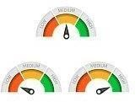

THE "WOW" IN OUR SOLUTION
Performance IFS(Z8>=5, "HIGH", Z8>=4,"MODERATE", Z8>=3, "LOW", TRUE, "VERY LOW")
3/21/2024 Annual Review
9

Slide 10
MODELLING
Data Collection:
Kaggle-Employee performance analysis. Features Collection:
*Emp id=Numerical Values.
*First Name and Last Name-Alphabet.
*Employee type.*Performance level.
*Gender Male and Female.
*Employees Rating Numerical values.
*Business unit.
*Employee status.
10

Slide 11
RESULTS
10

Slide 12
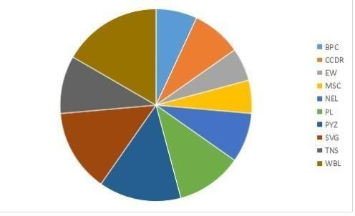

Slide 13
conclusion
Employee data analysis can help organizations improve performance, engagement, and retention, and make better decisions:
Performance:
Data analytics can help identify strengths and areas for improvement, and set clear goals. It can also help create a culture of accountability
and transparency by providing objective feedback.
Engagement:
Data analytics can help improve employee engagement by measuring key HR metrics.
Retention:
Data analytics can help improve retention rates by identifying the root causes of high turnover, developing solutions, and measuring their success.

Slide 14
Compliance:
Data analytics can help organizations maintain accurate and transparent performance records, which can help protect the company from legal disputes.
Decision making:
Data analytics can help organizations make data-driven decisions that align with their business goals.
Workforce planning:
Data analytics can help organizations improve workforce planning and talent management.

